Slide 1
Basics of Statistical Inference
School of Computer Science and Engineering
Faculty of Innovation and Technology
Taylor’s University

Slide 2
Outline
Population and sample
Discrete Random Variable
Probability Distribution of Discrete Random Variable
Continuous Random Variable
Probability Distribution of Continuous Random Variable
Fitting of Probability Distribution

Slide 3
Population Vs Sample
Sample A portion of the population selected for study is referred.
Data collection conducted to sample is called Survey
Population
Consists of all elements – individuals, items, or objects – whose characteristics are being studied. The population that is being studied is also called the Target Population
Data collection conducted to population is called Census

Slide 4
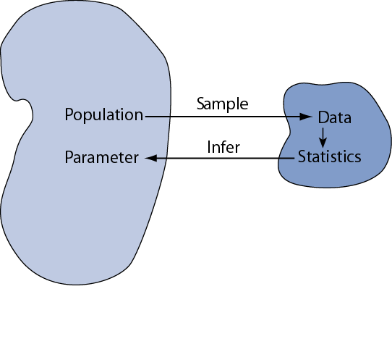
Statistical Inference
Statistical inference is the act of generalizing from a sample to a population with calculated degree of certainty.
using statistics calculated in the sample
We want to learn about population parameters…
Notes:
Statistical inference is the logical process by which we make sense of numbers. It is how we generalize from the particular (sample) to the general (population)
For example, when we do an experiment Each time we do an experiment, we expect different results due to chance. How do we deal with this chance variability?
Our first task is to distinguish between parameters and statistics. Parameters are the population value. Statistics are from the sample. The statistics will vary from sample to sample: they are random variables. In contrast, the parameters are invariable; they are constants.
To help draw this distinction, we use different symbols for parameters and statistics. For example, we use “mu” to represent the population mean (parameter) and “xbar” to represent the sample mean (statistic).

Slide 5
Discrete Random Variable
Random Variable
A random variable is a variable whose value is determined by the outcome of a random experiment. A random variable can be discrete or continuous.
Discrete Random Variable
A discrete random variable assumes values that can be counted. In other words, the consecutive values of a discrete random variable are separated by a certain gap.
no. of vehicles
Houses
fish caught
Complaints
customers
no. of heads obtained in tossing a coin twice.
Notes:
A random variable is called discrete if it has either a finite or a countable number of possible values. A random variable is called continuous if its possible values contain a whole interval of numbers.

Slide 6
Example of Discrete Random Variable
Find the random variable for the following and list all the possible outcome.
The number of tails obtained when three fair coins are tossed.
b) The sum of the scores when two ordinary dice are thrown.

Slide 7
Example a
The number of tails obtained when three fair coins are tossed
Probability Distribution of Discrete random Variable
X | Frequency | Probability
0 | 1 | 1/8
1 | 3 | 3/8
2 | 3 | 3/8
3 | 1 | 1/8
 | 8 | 1
S={HHH,HHT,HTH,HTT,THH,THT,TTH,TTT}
X={0,1,2,3}

Slide 8
Example b
x | Frequency | Probability
2 | 1 | 1/36
3 | 2 | 2/36
4 | 3 | 3/36
5 | 4 | 4/36
6 | 5 | 5/36
7 | 6 | 6/36
8 | 5 | 5/36
9 | 4 | 4/36
10 | 3 | 3/36
11 | 2 | 2/36
12 | 1 | 1/36
 | 36 | 1
The sum of the scores when two ordinary dice are thrown
 | 1 | 2 | 3 | 4 | 5 | 6
1 | 2 | 3 | 4 | 5 | 6 | 7
2 | 3 | 4 | 5 | 6 | 7 | 8
3 | 4 | 5 | 6 | 7 | 8 | 9
4 | 5 | 6 | 7 | 8 | 9 | 10
5 | 6 | 7 | 8 | 9 | 10 | 11
6 | 7 | 8 | 9 | 10 | 11 | 12
Sum={2,3,4,5,6,7,8,9,10,11,12}

Slide 9
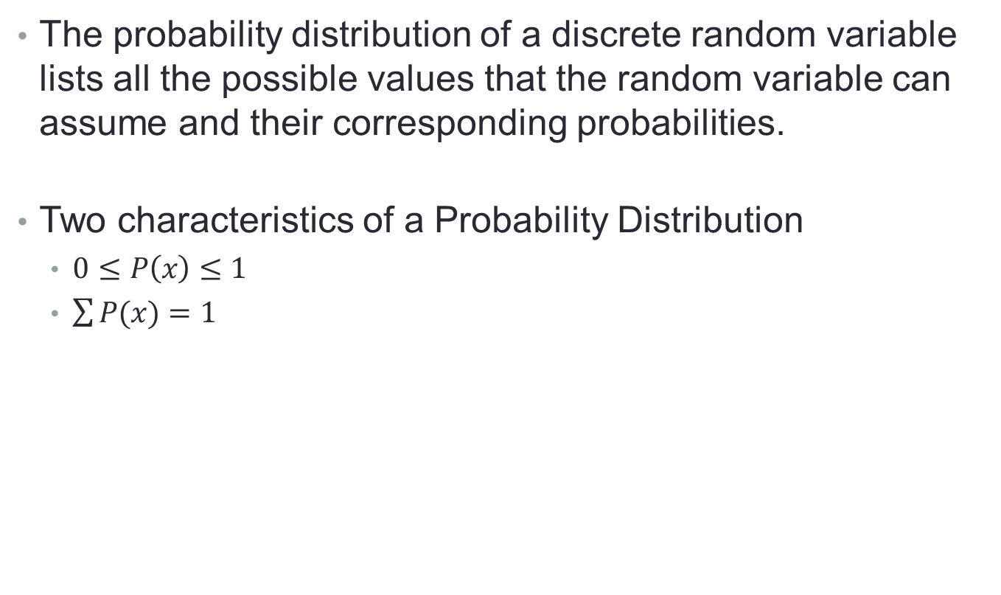
Probability Distribution of Discrete Random Variable
The probability distribution of a discrete random variable lists all the possible values that the random variable can assume and their corresponding probabilities.
Two characteristics of a Probability Distribution
$0≤P\left(x\right)≤1$
$\sum{P(x)}=1$

Slide 10
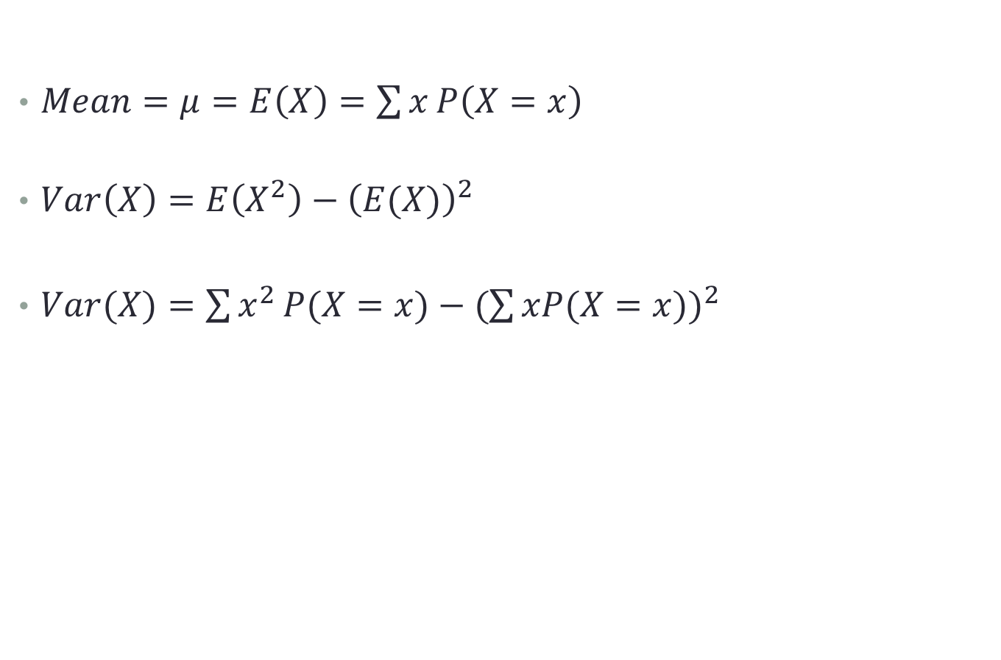
Mean and Variance of a Discrete Random Variable
$Mean=μ=E\left(X\right)=\sum{x}P\left(X=x\right)$
$Var\left(X\right)=E\left(X^{2}\right)−{\left(E(X)\right)}^{2}$
$Var(X)=\sum{x^{2}}P(X=x)−{(\sum{xP(X=x)})}^{2}$

Slide 11
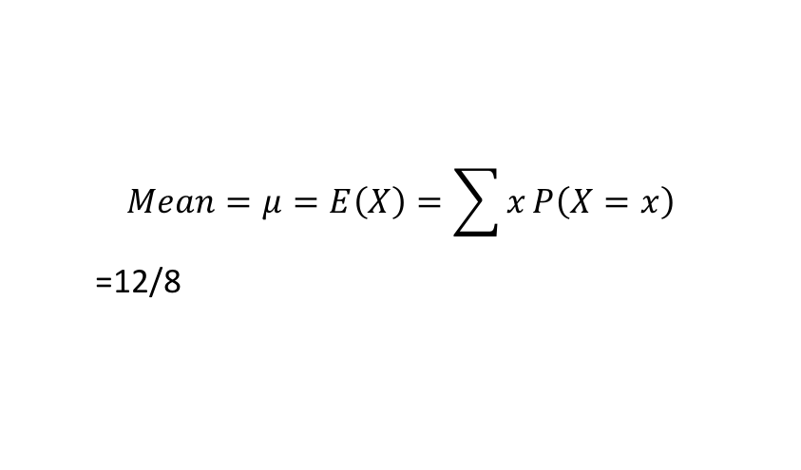
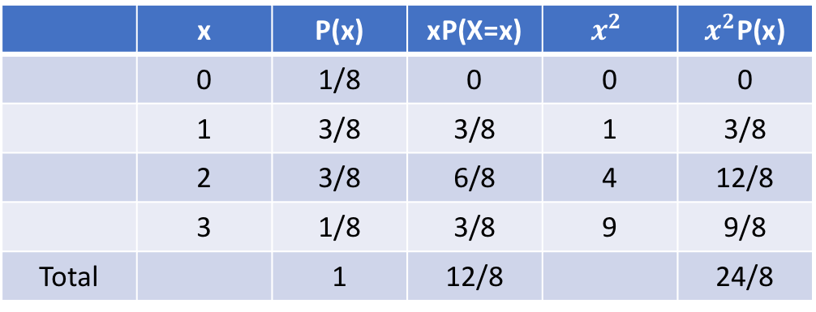

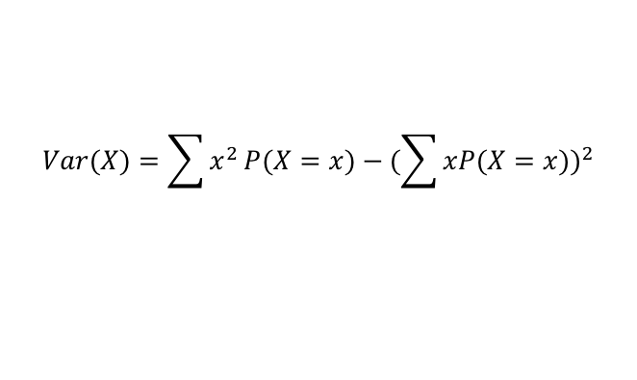
The number of tails obtained when three fair coins are tossed.
 | x | P(x) | xP(X=x) | $$x^{2}$$ | $x^{2}$P(x)
 | 0 | 1/8 | 0 | 0 | 0
 | 1 | 3/8 | 3/8 | 1 | 3/8
 | 2 | 3/8 | 6/8 | 4 | 12/8
 | 3 | 1/8 | 3/8 | 9 | 9/8
Total |  | 1 | 12/8 |  | 24/8
$$Mean=μ=E\left(X\right)=\sum{x}P\left(X=x\right)$$
=12/8
$$Var(X)=\sum{x^{2}}P(X=x)−{(\sum{xP(X=x)})}^{2}$$
=$\frac{24}{8}−{\left(\frac{12}{8}\right)}^{2}$

Slide 12
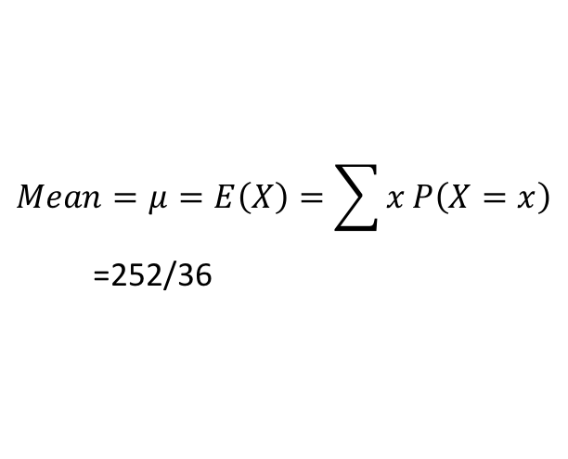
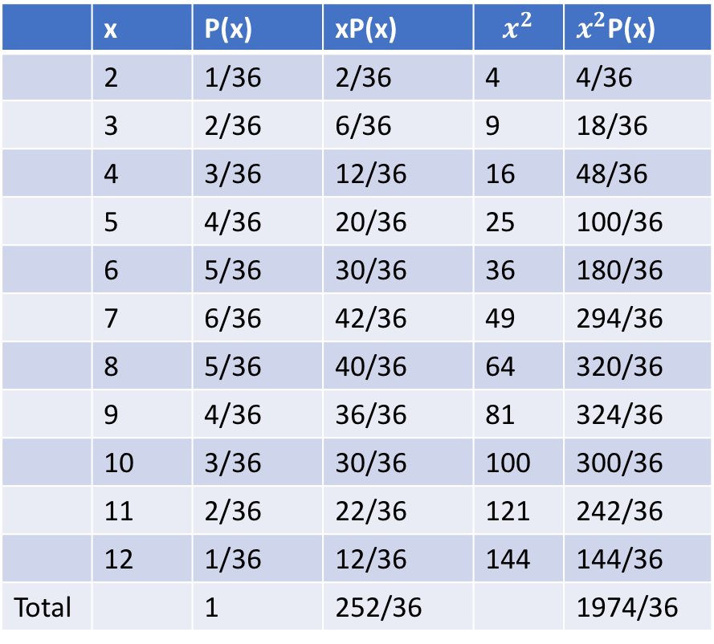

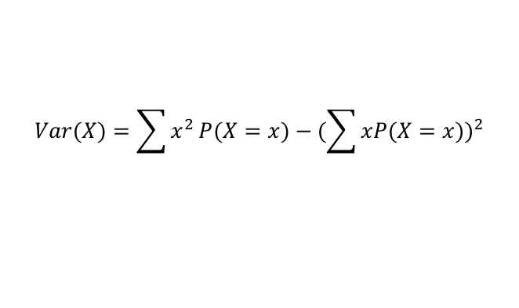

The sum of the scores when two ordinary dice are thrown
Find the mean and variance.
 | x | P(x) | xP(x) | $$x^{2}$$ | $x^{2}$P(x)
 | 2 | 1/36 | 2/36 | 4 | 4/36
 | 3 | 2/36 | 6/36 | 9 | 18/36
 | 4 | 3/36 | 12/36 | 16 | 48/36
 | 5 | 4/36 | 20/36 | 25 | 100/36
 | 6 | 5/36 | 30/36 | 36 | 180/36
 | 7 | 6/36 | 42/36 | 49 | 294/36
 | 8 | 5/36 | 40/36 | 64 | 320/36
 | 9 | 4/36 | 36/36 | 81 | 324/36
 | 10 | 3/36 | 30/36 | 100 | 300/36
 | 11 | 2/36 | 22/36 | 121 | 242/36
 | 12 | 1/36 | 12/36 | 144 | 144/36
Total |  | 1 | 252/36 |  | 1974/36
$$Mean=μ=E\left(X\right)=\sum{x}P\left(X=x\right)$$
=252/36
$$Var\left(X\right)=E\left(X^{2}\right)−{\left(E(X)\right)}^{2}$$
$$Var(X)=\sum{x^{2}}P(X=x)−{(\sum{xP(X=x)})}^{2}$$
=$\frac{1974}{36}−{\left(\frac{252}{36}\right)}^{2}$

Slide 13
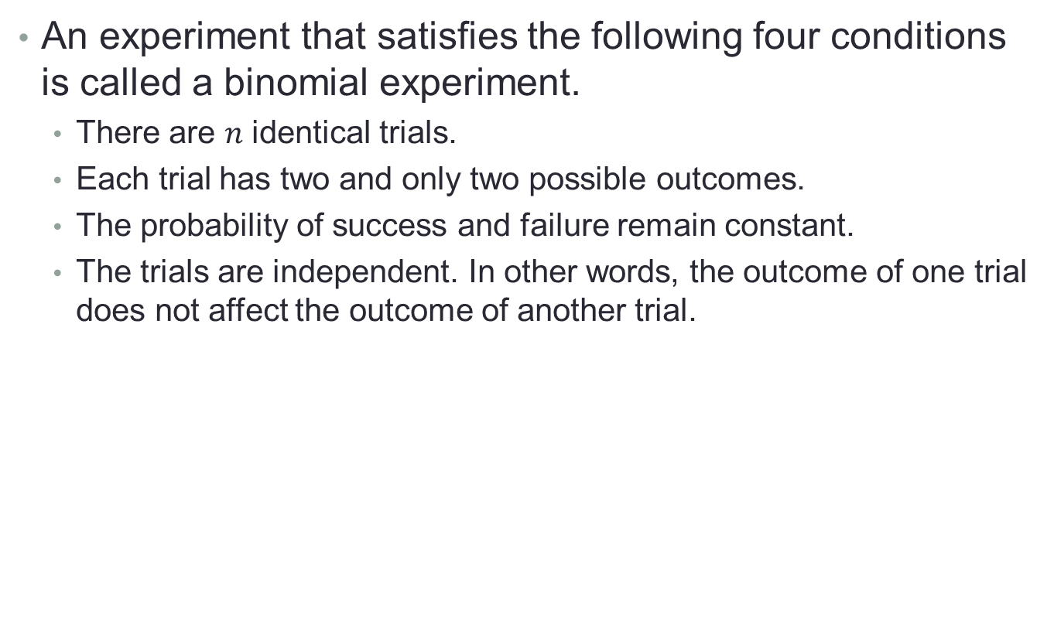
The Binomial Experiment
An experiment that satisfies the following four conditions is called a binomial experiment.
There are $n$ identical trials.
Each trial has two and only two possible outcomes.
The probability of success and failure remain constant.
The trials are independent. In other words, the outcome of one trial does not affect the outcome of another trial.
Notes:
Tossing a coin a hundred times to see how many land on heads.
Rolling two dice to see if you get a double.

Slide 14
The Binomial Experiment Example
which of the following are binomial experiments?
Telephone surveying a group of 200 people to ask if they voted for George Bush.
Counting the average number of dogs seen at street daily.
Notes:
is there a fixed number of trials?
For question #1, the answer is yes (200).
For question #2, the answer is no, so we’re going to discard #2 as a binomial experiment.
Are there only 2 possible outcomes?
For question #1, the only two possible outcomes are that they did, or they didn’t vote for Mr. Bush, so the answer is yes.
are the outcomes independent of each other? In other words, does the outcome of one trial (or one toss, or one question) affect another trial?
For question #1, the answer is yes: one person saying they did or didn’t vote for Mr. Bush isn’t going to affect the next person’s response.
Does the probability of success remain the same for each trial?
For question #1, the answer is yes, each person has a 50% chance of having voted for Mr. Bush.

Slide 15
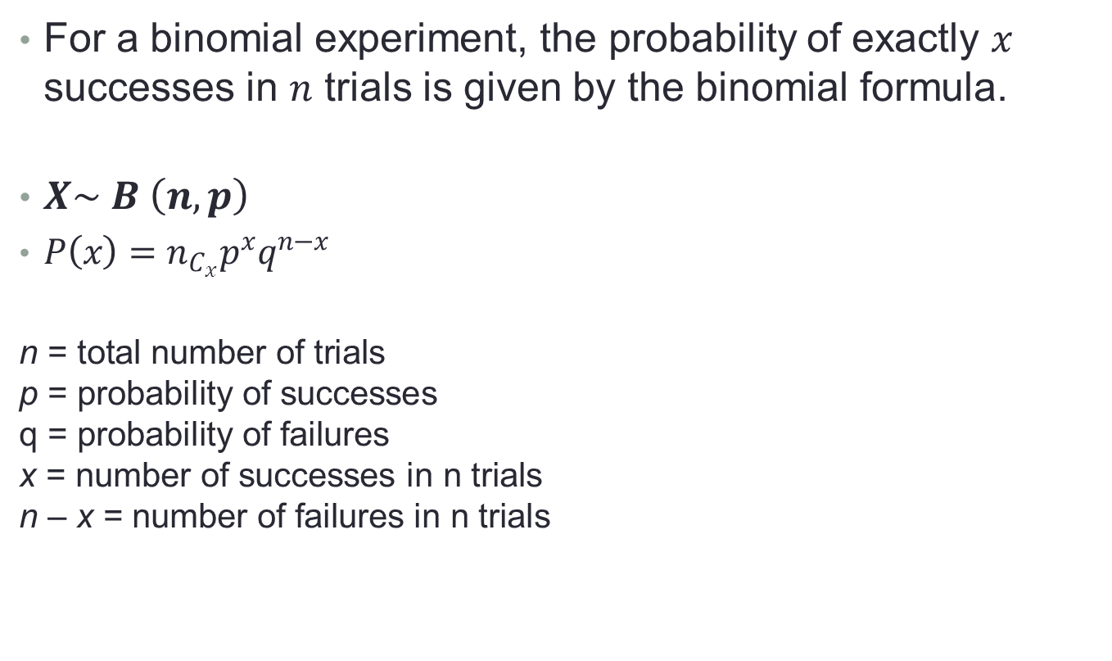
The Binomial Probability Distribution and Binomial Formula
For a binomial experiment, the probability of exactly $x$ successes in $n$ trials is given by the binomial formula.
$X\sim B \left(n, p\right)$
$P\left(x\right)=n_{C_{x}}p^{x}q^{n−x}$
$$\text{n}\text{ = }\text{total} \text{number} \text{of} \text{trials}$$
$$\text{p}\text{ = }\text{probability} \text{of} \text{successes}$$
$$\text{q}\text{ = }\text{probability} \text{of} \text{failures}$$
$$\text{x}\text{ = }\text{number} \text{of} \text{successes} \text{in} \text{n} \text{trials}$$
$$\text{n}\text{ – }\text{x}\text{ = }\text{number} \text{of} \text{failures} \text{in} \text{n} \text{trials}$$

Slide 16
Example
Five percent of all DVD players manufactured by a large electronics company are defective. A quality control inspector randomly selected three DVD players from the production line.
Construct a probability distribution for the number of defective DVD player.
Notes:
This example consists of three identical trials.
2. Each trial has two outcomes: defective or
good.
3. The probability
p
that a DVD player is
defective is .05. The probability
q
that a DVD
player is good is .95.
4. Each trial (DVD player) is independent.
Because all four conditions of a binomial
experiment are satisfied, this is an example of a
binomial experiment.

Slide 17
Example Solution
1. This example consists of three identical trials.
2. Each trial has two outcomes: defective or good.
3. The probability p that a DVD player is defective is .05. The probability q that a DVD player is good is .95.
4. Each trial (DVD player) is independent.
Because all four conditions of a binomial experiment are satisfied, this is an example of a binomial experiment.

Slide 18
Example
Five percent of all DVD players manufactured by a large electronics company are defective. A quality control inspector randomly selected three DVD players from the production line.
What is the probability that exactly one of these
three DVD players is defective?
Notes:
n = total number of trials = 3 DVD players x = number of successes = number of defective DVD players = 1 n – x = number of failures = number of good DVD players = 3 - 1 = 2 p = P(success) = .05 q = P(failure) = 1 – p = .95

Slide 19
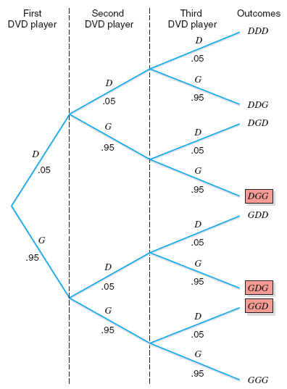
Tree diagram for selecting three DVD Players.

Slide 20
Example Solution
n = total number of trials = 3 DVD players x = number of successes = number of defective DVD players = 1 n – x = number of failures = number of good DVD players = 3 - 1 = 2 p = P(success) = .05 q = P(failure) = 1 – p = .95

Slide 21
Example Solution
The probability of selecting exactly one defective DVD player is

Slide 22
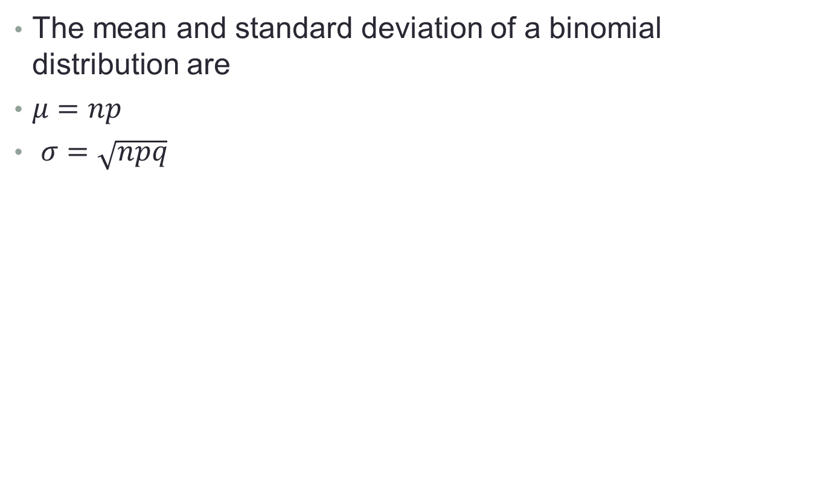
Mean and Standard Deviation of the Binomial Distribution
The mean and standard deviation of a binomial distribution are
$μ=np$
$σ=\sqrt{npq}$

Slide 23
Example
According to a Harris Interactive survey conducted for World Vision and released in February 2009, 45% of teens in the United States volunteer time for charitable causes. Assume that this result is true for the current population of U.S. teens. A sample of 40 teens is selected. Let x be the number of teens in this sample who volunteer time for charitable causes. Find the mean and standard deviation of the probability distribution of x.
Notes:
n = 40 p = .45, and q = .55

Slide 24
Example Solution
n = 40 p = .45, and q = .55
Using the formulas for the mean and standard deviation of the binomial distribution,

Slide 25
Continuous Random Variables

Slide 26
Frequency Distribution Table
Interval | Frequency | Relative Frequency | f(x)
1-20
21-40
41-60
61-80
81-100
101-120
Total

Slide 27
Consider the following table of sales, divided into intervals of 1000 units each,
interval | f | Relative Frequency
(0,1000] | 0 | 0/200
(1000,2000] | 10 | 10/200
(2000,3000] | 50 | 50/200
(3000,4000] | 60 | 60/200
(4000,5000] | 50 | 50/200
(5000,6000] | 20 | 20/200
(6000,7000] | 10 | 10/200

Slide 28
and the relative frequency of each interval.
interval | frequency | relative freq.
(0,1000] | 0 | 0
(1000,2000] | 10 | 0.05
(2000,3000] | 50 | 0.25
(3000,4000] | 60 | 0.30
(4000,5000] | 50 | 0.25
(5000,6000] | 20 | 0.10
(6000,7000] | 10 | 0.05
 | 200 | 1.00

Slide 29
We’re going to divide the relative frequencies by the width of the cells (which here is 1000). This will make the graph have an area of 1.
interval | relative freq.
(0,1000] | 0 | 0
(1000,2000] | 0.05 | 0.00005
(2000,3000] | 0.25 | 0.00025
(3000,4000] | 0.30 | 0.00030
(4000,5000] | 0.25 | 0.00025
(5000,6000] | 0.10 | 0.00010
(6000,7000] | 0.05 | 0.00005

Slide 30
Histogram
f(x) = p(x)
0.00030
0.00025
0.00020
0.00015
0.00010
0.00005
0
interval
(0,1000] | 0
(1000,2000] | 0.00005
(2000,3000] | 0.00025
(3000,4000] | 0.00030
(4000,5000] | 0.00025
(5000,6000] | 0.00010
(6000,7000] | 0.00005
0 1000 2000 3000 4000 5000 6000 7000 sales
The area of each bar is the relative frequency of the category, so the total area is 1.

Slide 31
Frequency Polygon
f(x) = p(x)
0.00030
0.00025
0.00020
0.00015
0.00010
0.00005
0
interval
(0,1000] | 0
(1000,2000] | 0.00005
(2000,3000] | 0.00025
(3000,4000] | 0.00030
(4000,5000] | 0.00025
(5000,6000] | 0.00010
(6000,7000] | 0.00005
0 1000 2000 3000 4000 5000 6000 7000 sales
Here is the frequency polygon.
Notes:
A frequency polygon is a line graph of class frequency plotted against class midpoint.
It can be obtained by joining the midpoints of the tops of the rectangles in the histogram

Slide 32
If we make the intervals 500 units instead of 1000, the graph would probably look something like this:
f(x) = p(x)
The height of the bars increases and decreases more gradually.
sales

Slide 33
If we made the intervals infinitesimally small, the bars and the frequency polygon would become smooth, looking something like this:
This what the distribution of a continuous random variable looks like.
This curve is denoted f(x) or p(x) and is called the probability density function.
f(x) = p(x)
sales
Notes:
Probability density function is a function that provides the likelihood that the value of a random variable will fall between a certain range of values.
We use the probability density function in the case of continuous random variables.
The graph of a probability density function is in the form of a bell curve.

Slide 34
pmf versus pdf
For a discrete random variable, we had a probability mass function (pmf).
The pmf looked like a bunch of spikes, and probabilities were represented by the heights of the spikes.
For a continuous random variable, we have a probability density function (pdf).
The pdf looks like a curve, and probabilities are represented by areas under the curve.

Slide 35
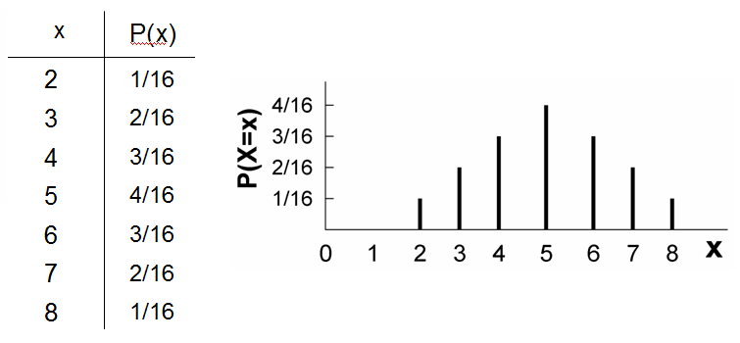
pmf
For a discrete random variable, we had a probability mass function (pmf).

Slide 36
Pr(a < X < b)
f(x) = p(x)
a b
sales

Slide 37
A continuous random variable has an infinite number of possible values & the probability of any one particular value is zero.
Notes:
The fact that the random variable has a zero probability of taking any one value is what distinguishes the continuous random variables from the discrete ones.
𝑃(𝑋=𝑥)=0 for any value 𝑥.

Slide 38
Example
f(x) = 2 if 1 ≤ x ≤ 1.5 and
f(x) = 0 otherwise
This function satisfies both the properties of pdfs.
First, it’s never negative.
Second, the total area under the curve is (1/2) (2) = 1.
f(x)
2.0
0 1.0 1.5 x

Slide 39
Rectangle Example: What is F(1.2)?
F(1.2) = Pr(X ≤ 1.2)
= the area under the pdf up to where x is 1.2.
= (0.2) (2.0)
= 0.4
f(x)
2.0
0 1.0 1.2 1.5 x

Slide 40
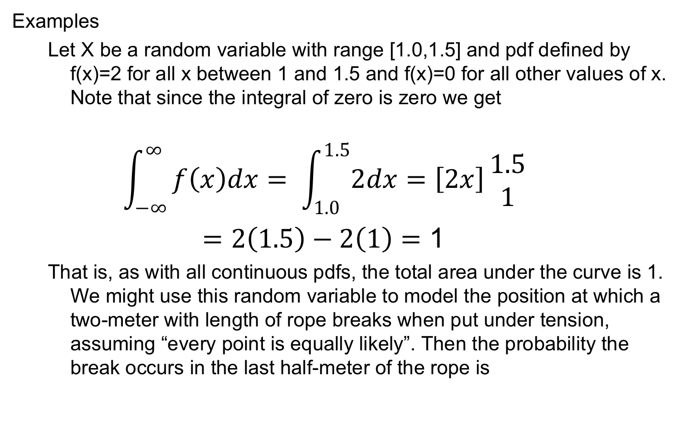
Definition and Basic Properties

Slide 41
Expectation and Variance
Definitions
The expected value of a continuous random variable X is defined by
Note the similarity to the definition for discrete random variables. Once again we often denote it by . As in the discrete case this integral may not converge, in which case the expectation if X is undefined.

Slide 42
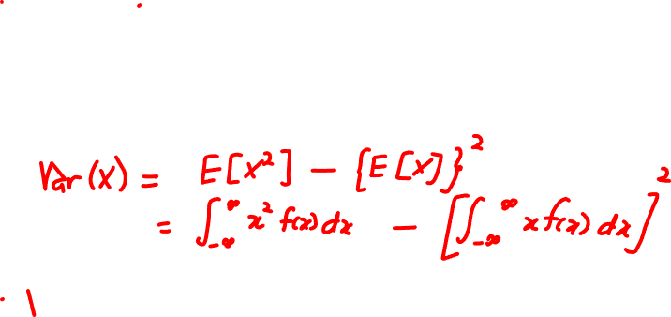
Expectation and Variance
Definitions
As in the discrete case we define the variance by
Once again the standard deviation is the square root of variance. Variance and standard deviation do not exist if the expected value by which they are defined does not converge.

Slide 43
Continuous Uniform Distributions.
Distributions like our rectangle example are called uniform distributions.
Notice that there are both discrete uniform distributions that we discussed earlier and continuous uniform distributions.

Slide 44
The continuous uniform distribution has the following form:
Notice that the area of the rectangle will always be 1 because
area = length • width

Slide 45
Mean, variance, and standard deviation of the continuous uniform distribution
mean:
variance:
standard deviation:

Slide 46
The most famous distribution is the Normal or Gaussian distribution.
Its probability density function (pdf) is
μ is the mean of the distribution, σ is the standard deviation,
It is sometimes denoted N (μ, σ²), which means the normal distribution with a mean of μ and a variance of σ².

Slide 47
Recall that if a random variable has mean μ and standard deviation σ, then (X-μ)/σ has mean 0 and standard deviation 1.
If X is normally distributed, then (X-μ)/σ will be standard normal, N(0,1), normal with mean 0 and variance 1.
This theorem is extremely useful.
It means that we don’t need to use the messy normal formula.
We can standardize any normal distribution and look up probabilities in tables for the standard normal distribution.

Slide 48
Example: If X is N(2, 9), determine Pr(X ≤ 5).
0.8413
0 1.00 Z

Slide 49
Example: Suppose that women’s heights are normally distributed with mean 64 inches & standard deviation 3 inches. What is the probability that a randomly selected woman is under five feet tall?
-1.33 0 Z

